Slide 1
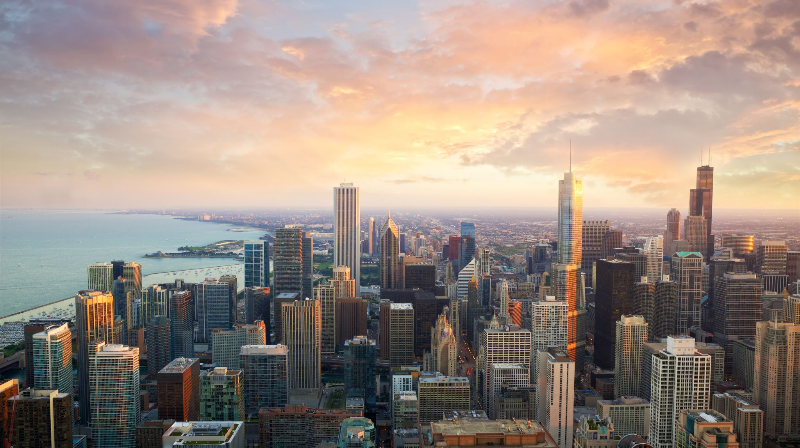
Capstone Project - The Battle of Neighborhoods

Slide 2
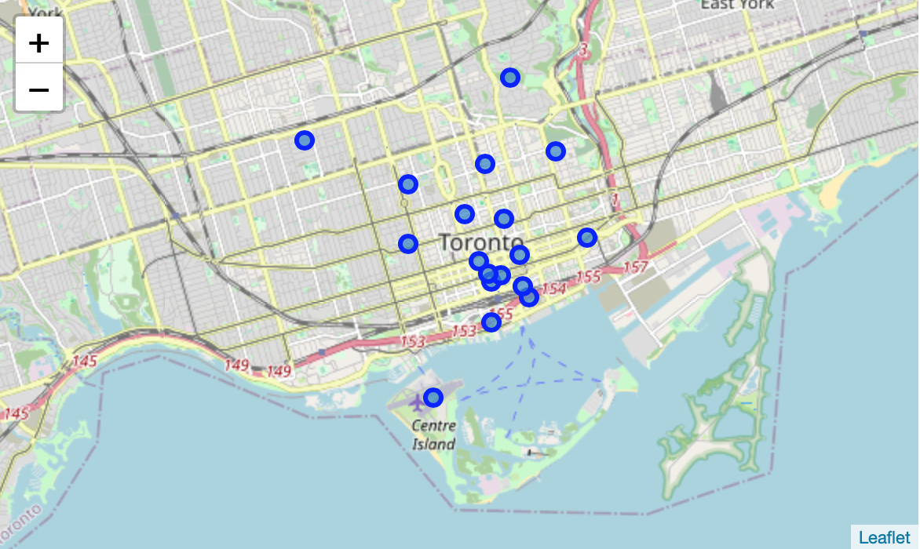
Clustering downtown Toronto

Slide 3
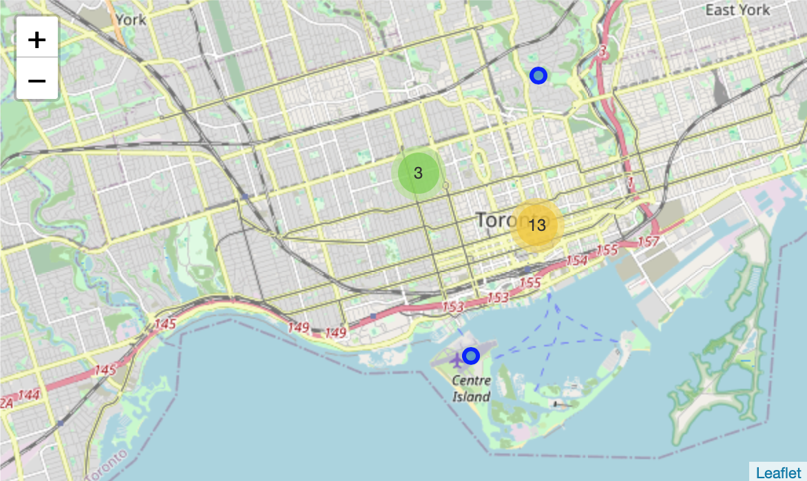
add markers to Toronto map

Slide 4
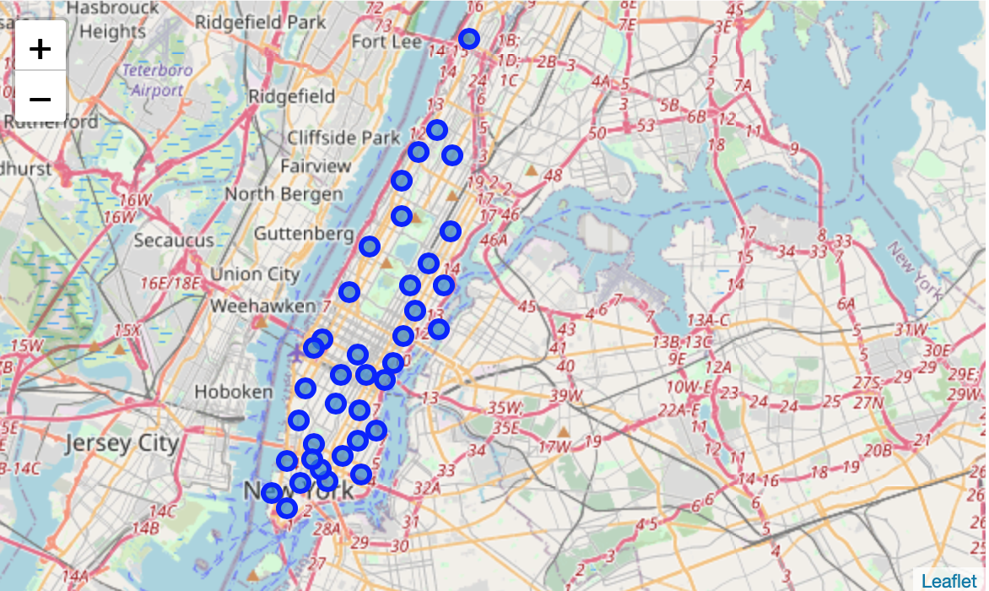
Clustering Manhattan

Slide 5
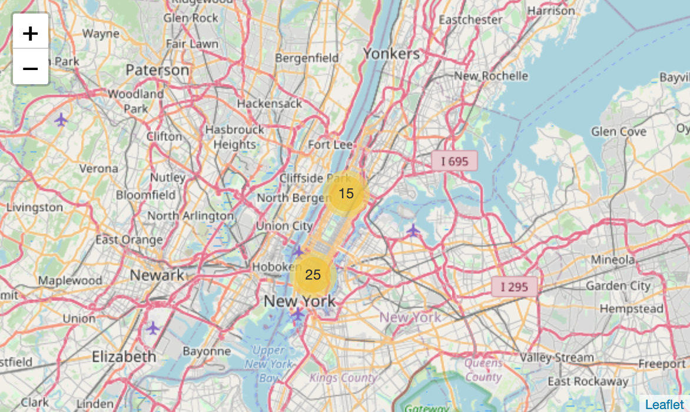
add markers to Manhattan map

Slide 6
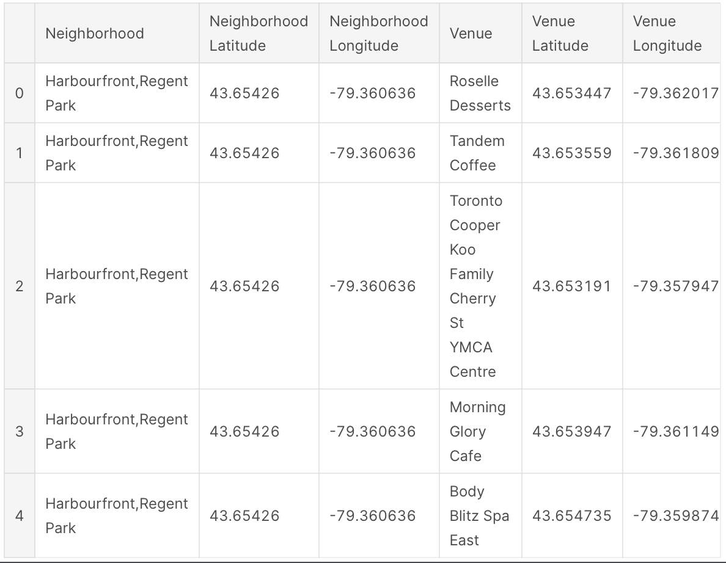
Exploring Neighborhoods in Downtown Toronto

Slide 7
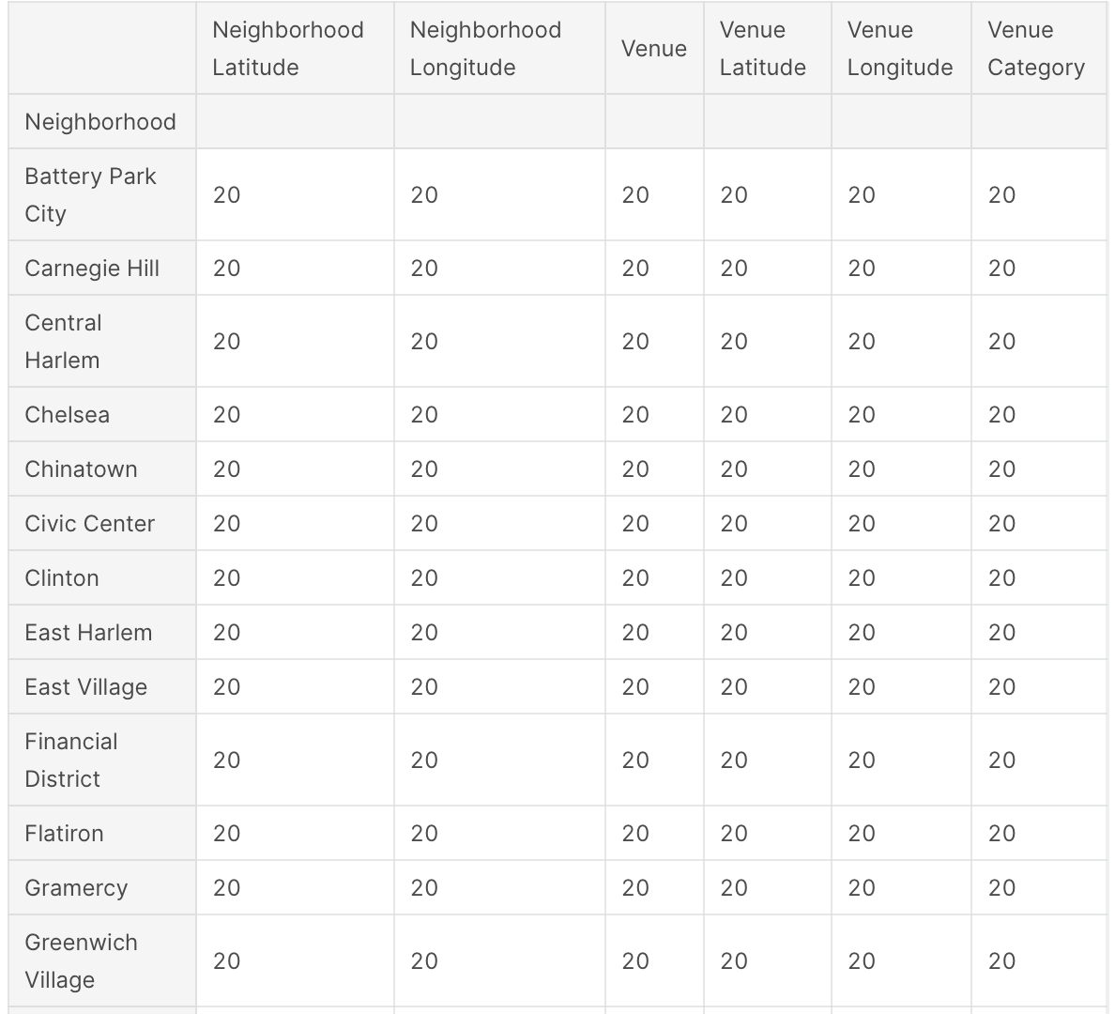
Exploring Neighborhoods in Manhattan

Slide 8
Observations
The historical place is only situated in Downtown Toronto and the Monument or landmark venue is in Manhattan neighborhoods
Airport facility, Harbor, Sculpture garden and Boat or ferry services are also available in Downtown Toronto while venues like Nightlife, Climbing gym and Museums are present in Manhattan

Slide 9
Recommendations
we recommend Downtown Toronto Neighborhoods will be considered first to open a restaurant.
The tourists have an easily travelling access due to Airport facility, which not only saves time but also helps to save money.

Slide 10
Conclusion
The downtown Toronto and Manhattan neighborhoods have more like similar venues. As we know that every place is unique in its own way, so that’s argument is present in both neighborhoods. The dissimilarity exists in terms of some different venues and facilities but not on a larger extent.

